Slide 1
Changes to Vehicle Registration
and Temporary Tags
As a Result of Act 41 of 2023

Slide 2
Webinar Participants
Wayne Hamric –
Administrator, Department of Finance and Administration Office of Driver Services and Motor Vehicles
Katrina Burnett –
Division Manager, Department of Finance and Administration Office of Driver Services and Motor Vehicles
Greg Kirkpatrick –
President, Arkansas Automobile Dealers Association

Slide 3
Presentation Overview
Act 41 of 2023
Vehicle Registration
Temporary Tags
Changes to SecureETag System
Misuse of Temporary Tags Monitoring Plan
Q & A

Slide 4
ACT 41 of 2023

Slide 5
ACT 41 of 2023
continued

Slide 6
ACT 41 of 2023
continued

Slide 7
Key Changes Resulting From Act 41 of 2023
Extends the time requirements for vehicle registration from 30 to 60-days; ​
Temporary paper tags will also be extended from 30 to 60-days;
This change will affect passenger cars, motorhomes, motorcycles and commercial trucks.​ Motorboats are excluded;
Trailer temporary tags will continue to expire in 30-days; and,​
The 60-day rule will affect vehicles purchased on or after 08/01/23. Vehicles purchased before 08/01/23 are required to be registered within 30-days.​

Slide 8
Presentation Overview
Act 41 of 2023
Vehicle Registration
Temporary Tags
Changes to SecureETag System
Misuse of Temporary Tags Monitoring Plan
Q & A

Slide 9
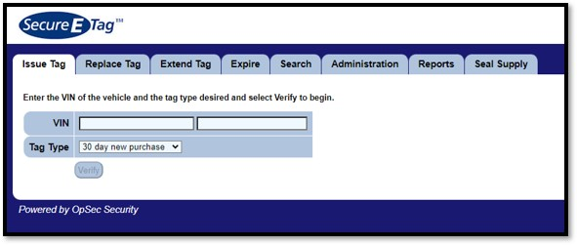
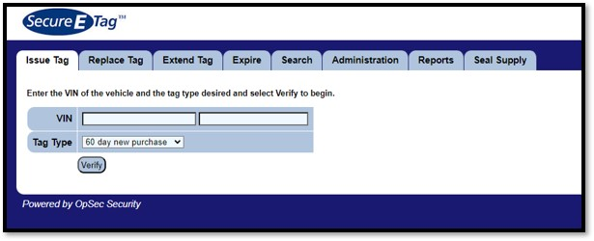
Before 8/1/2023
After 8/1/2023

Slide 10
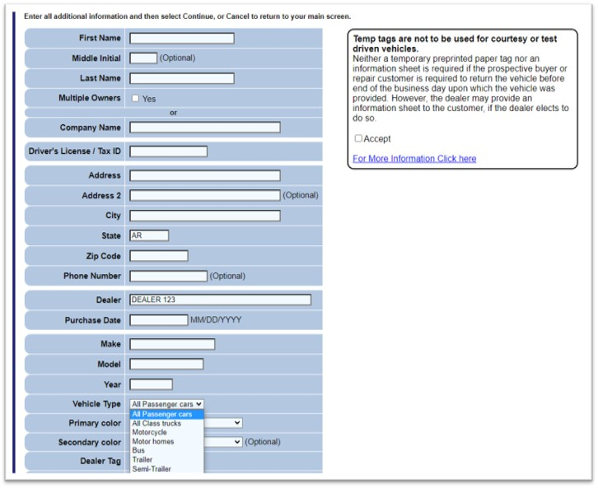
New SecureETag
Disclosure

Slide 11
Presentation Overview
Act 41 of 2023
Vehicle Registration
Temporary Tags
Changes to SecureETag System
Misuse of Temporary Tags Monitoring Plan
Q & A

Slide 12
Types and Uses of Temporary Tags (As of August 1, 2023)
60-day new purchase (Cars, Commercial Trucks & Motorcycles); ​
30-day new purchase (Trailers);
14-day loaner (Use only when customer’s vehicle is being repaired at the dealership shop);
72-hour demonstration (Prospective buyers to take home, does not include test drives); and,​
72-hour transport (Use on dealer owned vehicle for the purpose of transporting).​

Slide 13
Temporary Tag DO NOTS
DO NOT extend or reissue a temporary tag because paperwork has been lost; ​
DO NOT extend or reissue a temporary tag because a customer cannot pay sales tax;
DO NOT extend or reissue a temporary tag because the title or paperwork has not be received.

Slide 14
Temporary Tag Misuse Monitoring
Law enforcement will strictly enforce the legal use of temporary tags; ​
SecureETag users will be monitored for potential improper issuance of temporary tags;
Misuse of temporary tags may result in a suspension by the user and/dealership from issuing temporary tags through the SecureETag site;
Misuse of temporary tags may result in both misdemeanor or felony charges.

Slide 15
Temporary Tag Usage and Monitoring: DFA Letter

Slide 16
Temporary Tag Usage and Monitoring: ARS Letter

Slide 17
ANY QUESTIONS?
For additional information or if you have any questions do not hesitate to contact AADA at 501-372-2596 or email info@arstemptags.com

